Slide 1

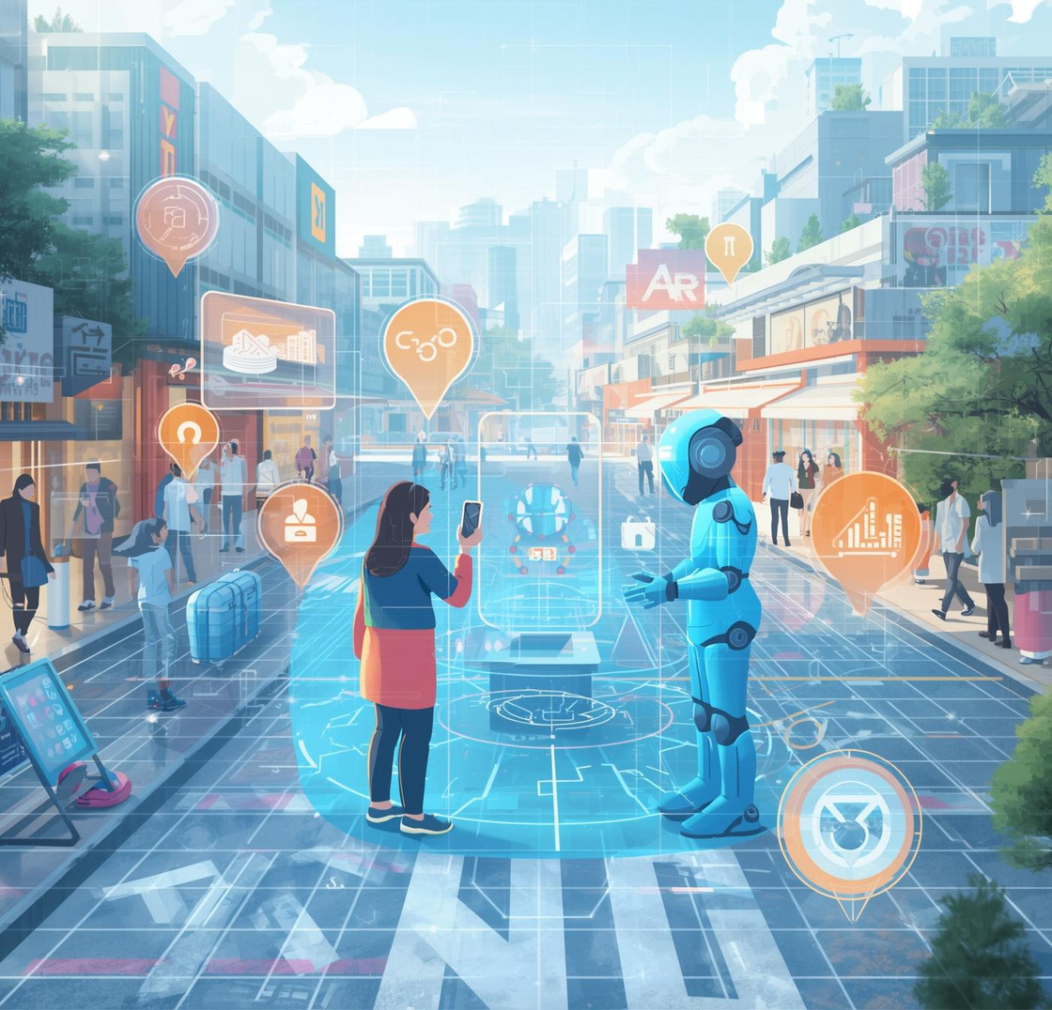
Introducing a revolutionary platform for modern engagement
AR-HOST: A Platform for AI-Powered AR Agents
Redefining engagement by merging physical spaces with AI-driven augmented reality experiences.

Slide 2
Major Challenges in Business
High Staffing Costs
Businesses are facing escalating expenses associated with hiring and maintaining staff, impacting their profitability.
Static Advertising
Traditional advertising methods often yield limited engagement, failing to capture customer attention effectively.
Inconsistent Customer Service
Lack of personalization in interactions
Variable quality across service staff
Difficulty maintaining service standards consistently

Slide 3
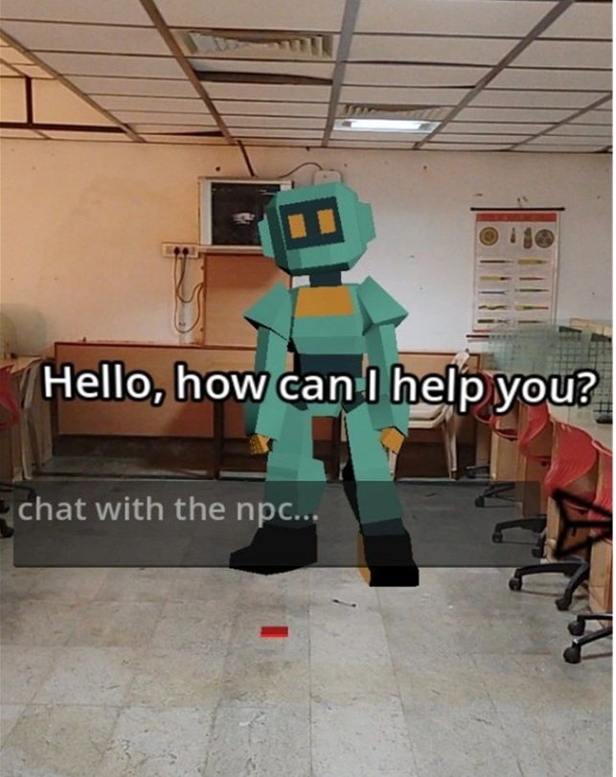
Solution Overview of AR-HOST
Innovative AI-Powered Engagement for Physical Spaces
AR-HOST revolutionizes customer interactions by deploying AI-powered augmented reality agents in physical locations. Our platform creates an immersive experience that enhances engagement, personalization, and efficiency, addressing the critical challenges faced by modern businesses in real-time.

Slide 4




Efficient Coffee Shop
This image illustrates how AR technologies can streamline service, allowing customers to engage with a digital menu, reducing reliance on physical staff for enhanced efficiency.
Consistent Customer Experience
This graphic represents a restaurant utilizing AR technology to ensure a consistent customer experience, providing personalized service and information through augmented reality, tailored to each patron's needs.
Retail Transformation
Enhanced Dining Experience
The image captures a restaurant atmosphere where AR technology provides diners with interactive meal options, demonstrating a blend of technology and hospitality to ensure satisfaction and consistency.
In this visual, the implementation of AR solutions in retail demonstrates reduced physical clutter by offering virtual displays, enhancing customer interaction while maintaining a tidy environment.

Slide 5
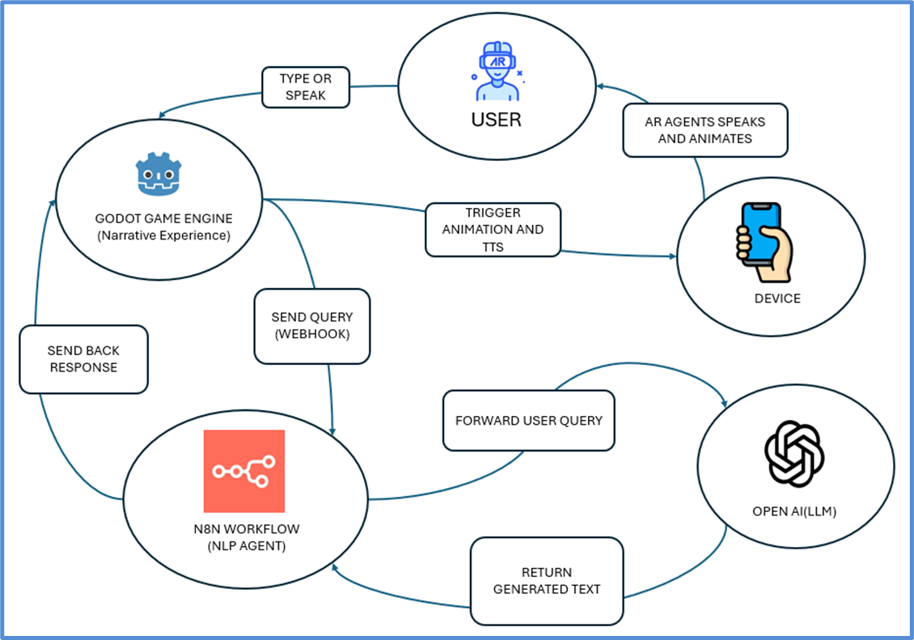


Technical Stack and Architecture Overview
The AR-HOST platform utilizes advanced technologies to ensure robust performance and scalability.

Slide 6
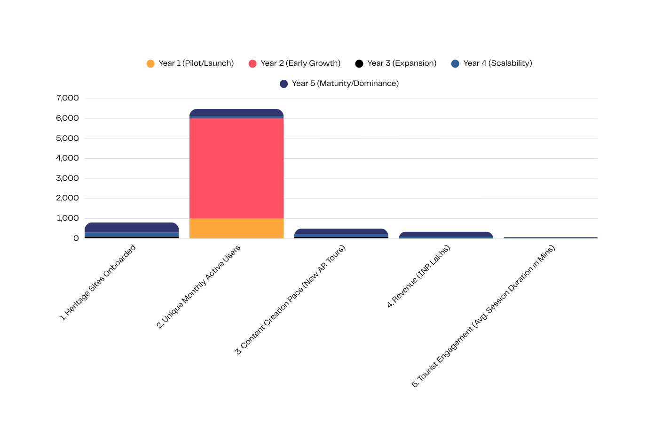

Sustainability of AR-HOST in a Growing Market
The augmented reality market is expanding rapidly, presenting substantial opportunities for innovative solutions like AR-HOST in various sectors.
The AR market's growth, projected at $2.8 billion with a remarkable CAGR of 33.5%, indicates a strong demand for cutting-edge technology. This trend suggests that AR-HOST can thrive by addressing the evolving needs of businesses seeking cost-effective, engaging digital experiences.

Slide 7


Prototype Features Overview
Geofenced AR Agent
Asynchronous Multi-User Interaction
Interactive AR agents engage customers in specified physical locations.
Multiple users can interact simultaneously with AR elements for enhanced experiences.

Slide 8

Project Roadmap
MVP
Multilingual Agents
Launch Marketplace
Initial Launch with Pilot Businesses
Expanding User Accessibility Worldwide
Expanding Global Market Presence
Launching MVP with ten pilot businesses for real-world testing.
Introducing multilingual agents to cater to diverse user needs.
Launching the marketplace for broader access and scalability.

Slide 9
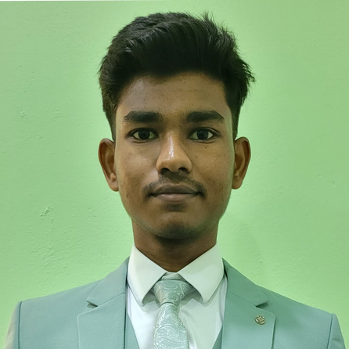
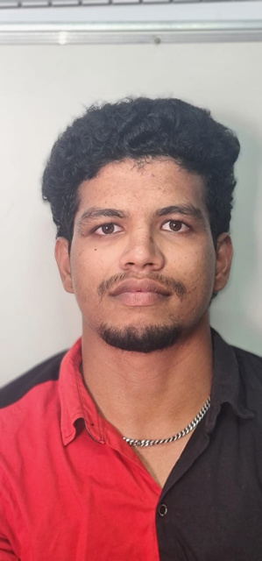

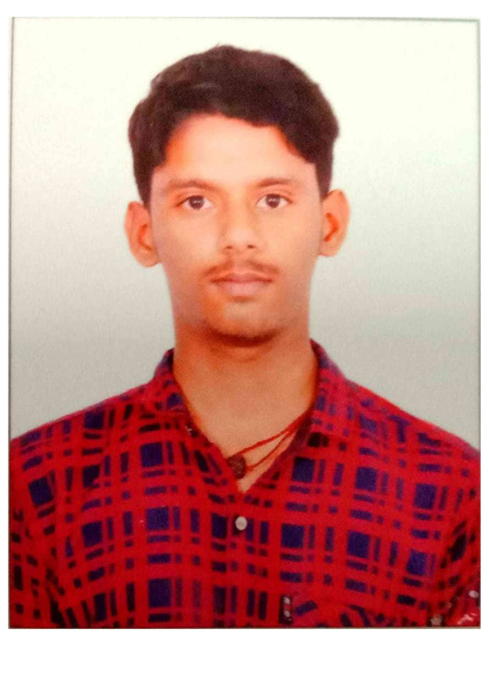
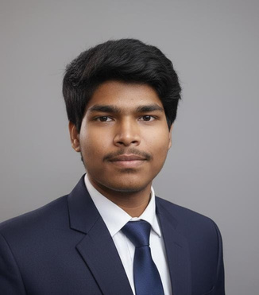
Nasheeth Ahmed A
Ansar Basha J
Nasheeth is a Tech Lead and AR/AI Engineer with extensive expertise in developing innovative augmented reality solutions and integrating AI technologies for enhanced user experiences.
Ansar specializes in 3D design for immersive environments, bringing creativity to life and ensuring that the visual elements are both engaging and functional within the AR space.
Harsh Kumar Dubey M
Harsh is an expert AI Agent Developer, focusing on creating intelligent AR agents that enhance user interaction and provide personalized experiences in physical locations.
Kalaiganesh R
Kalai is an Application developer who has all the in’s and out’s of developing an application regardless of its complexities or hurdles it needs to be tackled.
Suriya Ganesh J T
Team SpiritView
Suriya is a Game Developer who is innately creative and makes such lavish environments encompassing make form of media for entertainment.
Meet the minds behind AR-HOST, redefining engagement through augmented reality

Slide 10
Get in Touch
We welcome your inquiries and collaboration opportunities in shaping the future of AR technology.
Phone
+91 9442669492
Email
nasheethahmeda04@gmail.com

